Slide 1

DNA and RNA Assembly

Slide 2
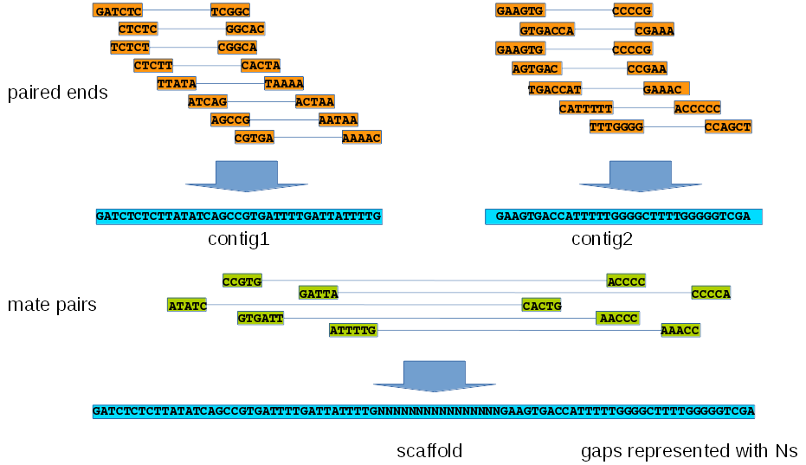
Assembly Results in Contigs and Scaffolds

Slide 3

Genome Assemblers Assemble using k-mers
GATTACGTACGTATCGTACGTA
GATTACGTACG
ATTACGTACGT
TTACGTACGTA
TACGTACGTAT
ACGTACGTATC
CGTACGTATCG
GTACGTATCGT
TACGTATCGTA
ACGTATCGTAC
CGTATCGTACG
GTATCGTACGT
TATCGTACGTA
One example sequence read
(length = 22 bp)
kmer size = 11
If you set kmer size = 23 then reads shorter than 23 bp will not be used in the assembly

Slide 4
Short read de novo Assemblers
small genomes (bacteria, fungi)
SPAdes
Velvet
minia (low memory, high disk usage)
any size genome
MaSuRCA
SGA
ABySS
ALLPATHS-LG
WGS

Slide 5
Gaps and Fragments in Assemblies
Repetitive regions can lead to a fragmented assembly
Transposable Elements
Ribosomal genes
Duplicated genes
Duplicated chromosomal regions
Low (<40) or high (>60) %GC can result in reduced Illumina sequence coverage
Need adequate (>30x) sequence coverage for assembler to extend contigs with confidence
Can use specialized tools to resolve gaps resulting from low sequence coverage
module spider GapFiller
module spider Opera
module spider SSPACE

Slide 6
DNA Repetitive Regions
1000 bp
400 bp
400 bp
400 bp
If a repeat is longer than both the read length and the distance between paired reads it becomes impossible to resolve the repeat region of the graph.
This means that even with a high coverage of error free reads, the result of an assembly will still be fragmented if long repeat regions are present.
White Paper: de novo Assembly in CLC Assembly Cell 4.0

Slide 7
Use Multiple Libraries to Resolve Repeat Regions
chromosome
1000 bp repeat 1000 bp repeat 5000 bp repeat
Paired end library
400 bp
Mate pair library
2000 bp
Mate pair library
10,000 bp

Slide 8
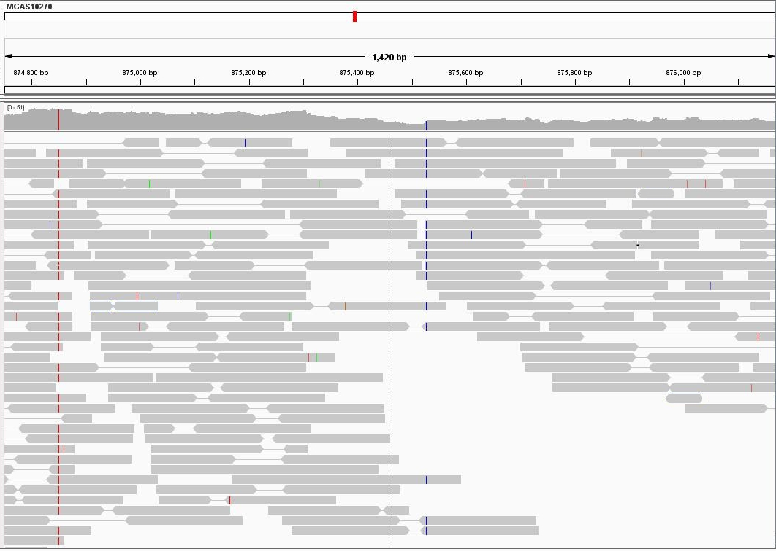
Example of Gap in a Region of Low Coverage Coverage (< 15x)

Slide 9
Gap Filling Results
TACACCTTCAGGAATATAGTTGGCTACTTTTGTTGGCAAACCTATGCCTAAGTTGACCAG
TGTATTGTGTTCTAATTCTTGTGCTACACGCTTTGCAATACGTGTTTGAATCTCTTCTTT
TGAAAGAACAGTAGCTGATGTTCCCATGTTAGGCTCCTTTCACTAAGTAGTTAACAAAAA
TGCCAGGAGTATGGACAAAATTAGGATCCATTTGCCCCACGTCAACAATTTCTCTTGCTT
CAACAATGGTGGTTTTCGCATTAGCAGCCATCACATGATTAAAGTTATTTTCAGAACCTG
CGTATTGCAAATTGCCATTTTTATCTGCCTTGTTAGCAAAAATAAGTGCGACATCAGCTT
TCAAAGGTTTTTCAAGAAGGTAGTCTTTGCCGTCAATAGTAATGACTTCTTTTCCTTTGN
NNNNNNNNNNNNNNNNNNNNNNNNNNNNNNNNNNNNNNNNNNNNNNNNNNNNNNNNNNNN
NNNNNNNNNNNNNNNNNNNNNNNNNNNNNNNNNNNNNNNNNNNNNNNNNNNNNNNNNNNN
NNNNNNNNNNNNTTTGTCGGCCCGCTTCACGGTTGAGACCGATATGTGATGCAATAATAG
TTGAAAACTGTTTATTGGCAACCATCTTACCAACGCCTTTGTCAGGAAAACCGGCATCGT
TACAGATTAAAGTGAGGTCTTTGACACCTTTTTCCACAAGTGCATCAATTAATTTTTCTG
GTGTGCCATTTGTCATGAAGCCACCAACCATAATGGTATCACCATCTTTAACGTGAGCTA
CCGCTTCTTTTATTGTGATTTCTTTACACATTTTTTCTACCAACTTTCACGAGACTAAGT
ATTGTTTTTCACGATAACAGCAGTTCCTTGTCCTCCACCAATGCAAAGTGTTGCTAGTCC
contig
134 Ns
before filling gap
scaffold
TACACCTTCAGGAATATAGTTGGCTACTTTTGTTGGCAAACCTATGCCTAAGTTGACCAG
TGTATTGTGTTCTAATTCTTGTGCTACACGCTTTGCAATACGTGTTTGAATCTCTTCTTT
TGAAAGAACAGTAGCTGATGTTCCCATGTTAGGCTCCTTTCACTAAGTAGTTAACAAAAA
TGCCAGGAGTATGGACAAAATTAGGATCCATTTGCCCCACGTCAACAATTTCTCTTGCTT
CAACAATGGTGGTTTTCGCATTAGCAGCCATCACATGATTAAAGTTATTTTCAGAACCTG
CGTATTGCAAATTGCCATTTTTATCTGCCTTGTTAGCAAAAATAAGTGCGACATCAGCTT
TCAAAGGTTTTTCAAGAAGGTAGTCTTTGCCGTCAATAGTAATGACTTCTTTTCCTTTGG
CAACTTCGGTTCCTATTCCAGTAGGTGTTAAGAAACCGCCTAGCCCAAAACCGCCACTGC
GGATGCGCTCAGCTAATGTTCCCTGAGGTACAAGATCAATTACAGTCTCGCCCTCAGTCA
TTTGTCGGCCCGCTTCACGGTTGAGACCGATATGTGATGCAATAATAGTTGAAAACTGTT
TATTGGCAACCATCTTACCAACGCCTTTGTCAGGAAAACCGGCATCGTTACAGATTAAAG
TGAGGTCTTTGACACCTTTTTCCACAAGTGCATCAATTAATTTTTCTGGTGTGCCATTTG
TCATGAAGCCACCAACCATAATGGTATCACCATCTTTAACGTGAGCTACCGCTTCTTTTA
TTGTGATTTCTTTACACATTTTTTCTACCAACTTTCACGAGACTAAGTATTGTTTTTCAC
GATAACAGCAGTTCCTTGTCCTCCACCAATGCAAAGTGTTGCTAGTCCTCTGGTTACTTG
121 nucleotides
after filling gap
contig

Slide 10
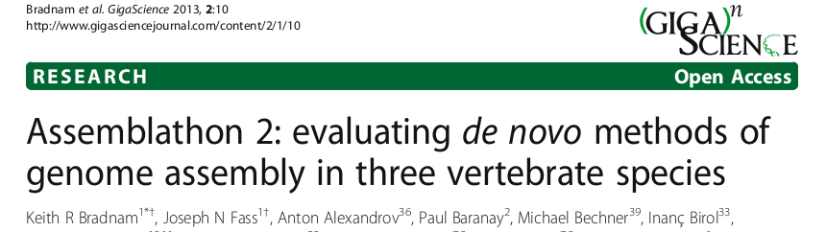
Other Assembly Considerations
Reference Assisted Genome Assembly
Merge multiple assemblies
Assemblathon 2 results
module spider Metassembler

Slide 11
Evaluating a Bacterial Genome Assembly

Slide 12
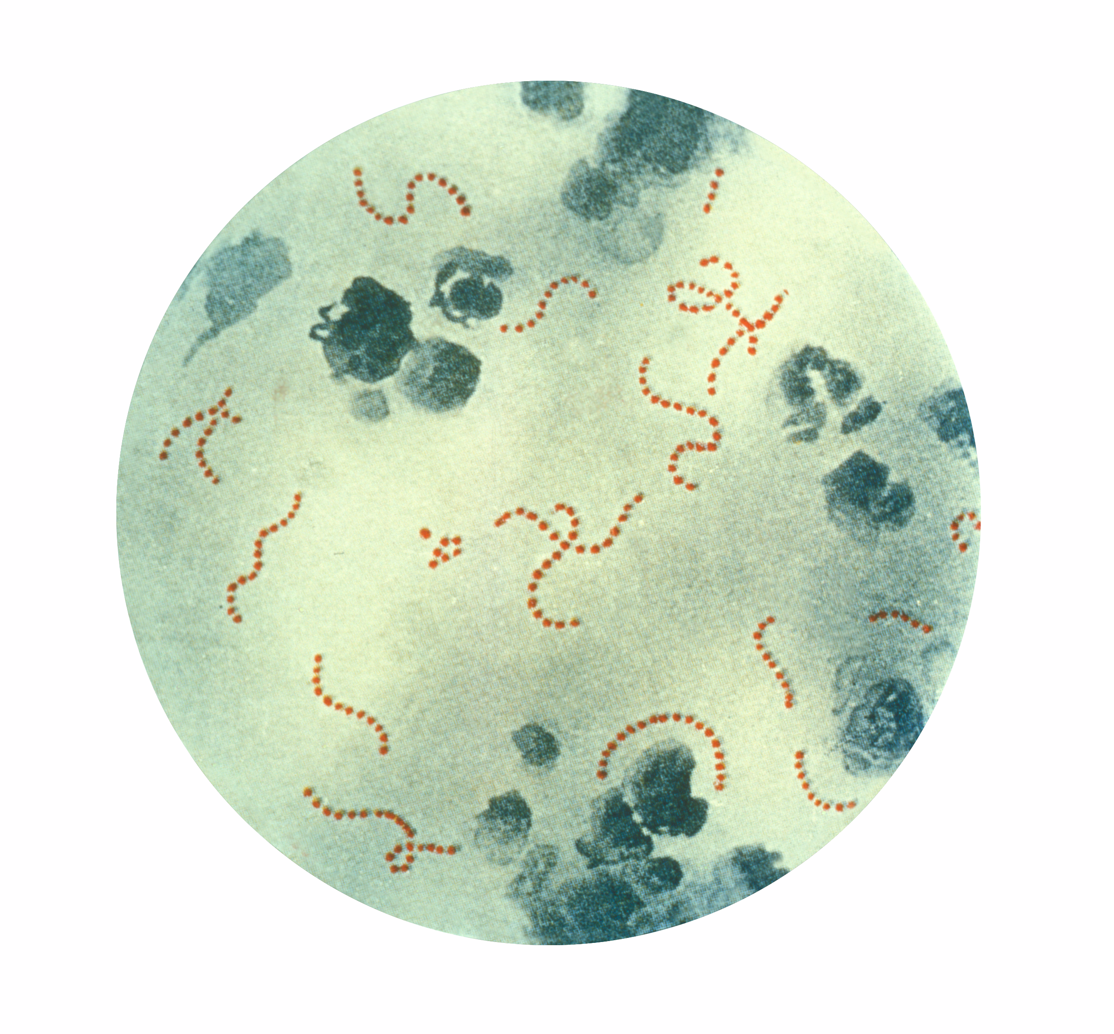
Streptococcus pyogenes
Bacteria that infect millions worldwide
Circular DNA
~1,850,000 bp long
~1,800 protein coding genes
20+ reference builds available
Centers for Disease Control and Prevention
http://phil.cdc.gov

Slide 13
Repeat Regions in S. pyogenes MGAS8232
Ribosomal Subunits
16S 23S 5S tRNAs
6 copies ~5000 bp each
Transposase Genes
14 copies of a ~1000 bp transposase
10 copies have 100% identity.

Slide 14
Transposase BLAST Alignment to S. pyogenes strain MGAS8232
Gene symbol spyM18_0426
Gene description transposase
Identity
1. 1026/1026(100%)
2. 974/974(100%)
3. 977/979(99%)
4. 973/973(100%)
5. 973/973(100%)
6. 973/973(100%)
7. 972/972(100%)
8. 972/972(100%)
9. 972/972(100%)
10. 972/972(100%)
11. 972/972(100%)
12. 743/745(99%)
13. 743/745(99%)
14. 743/745(99%)

Slide 15

reference genome represented by grey circle
Reference genome:
S. pyogenes
MGAS8232
ASM728v1 (2002)
1,895,017 bp

Slide 16

genes marked by red and green bars
Reference genome:
S. pyogenes
MGAS8232
ASM728v1 (2002)
1,895,017 bp

Slide 17
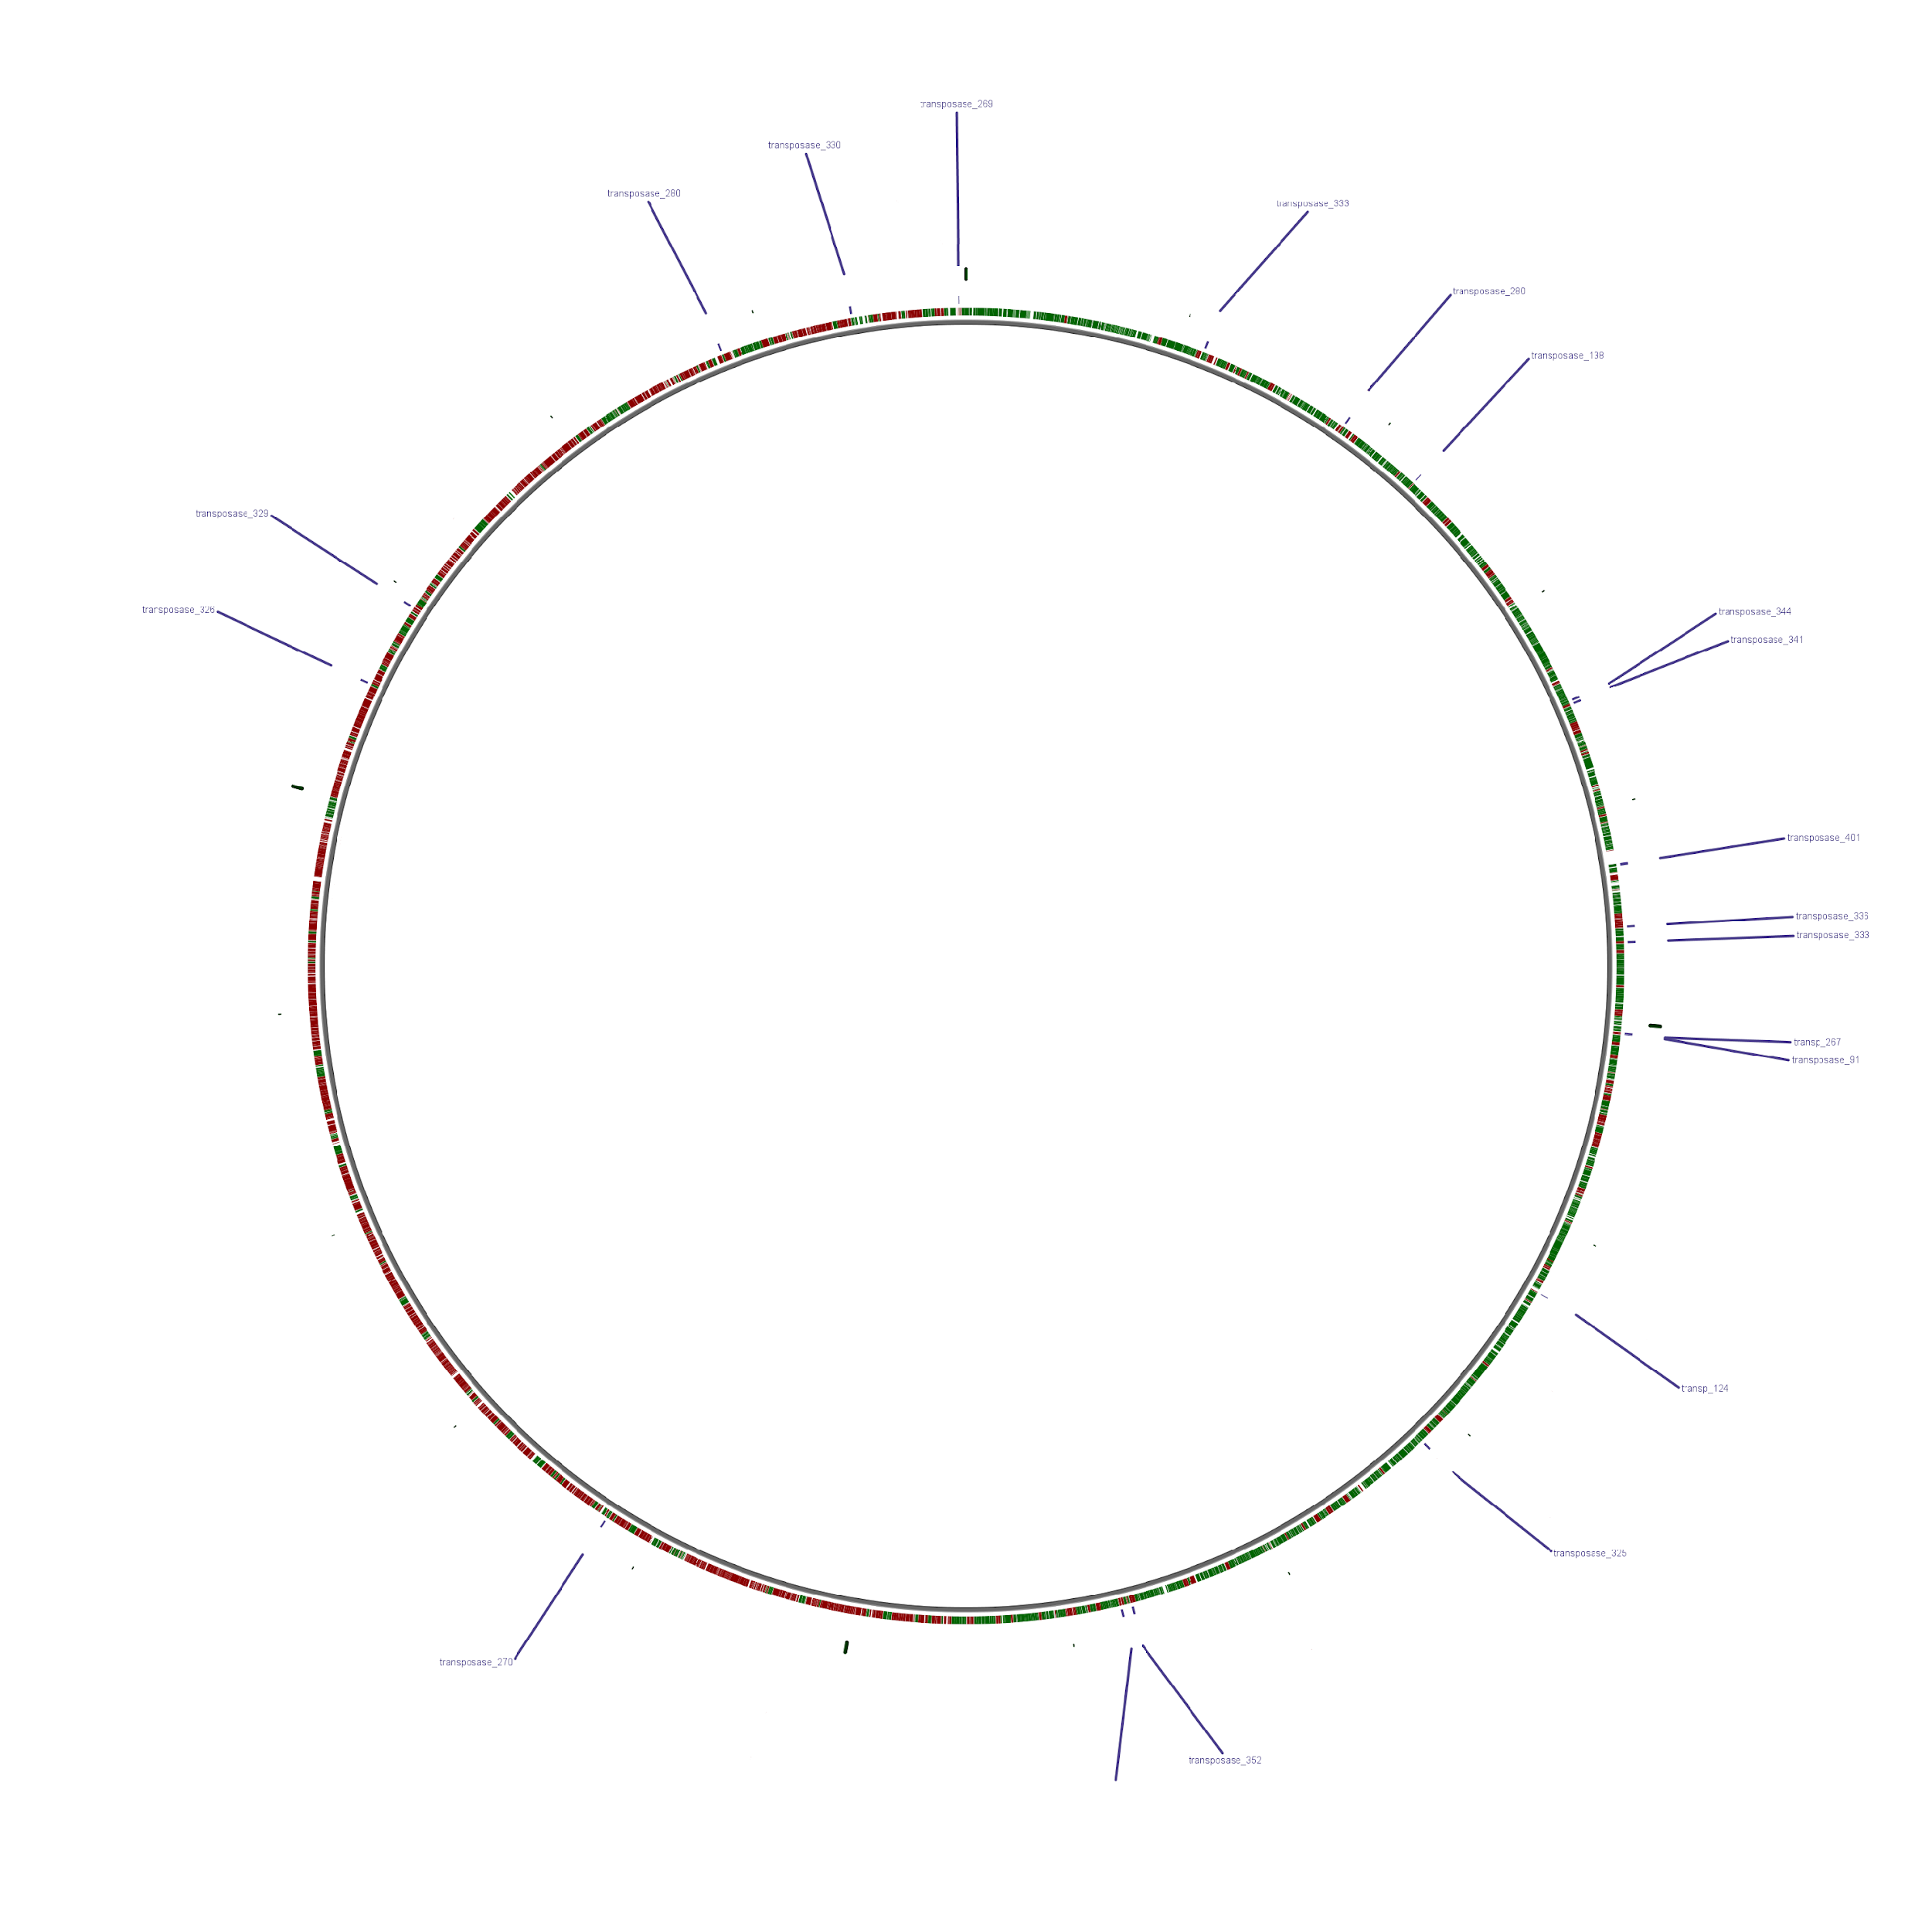
transposase genes
(1000 bp)
Reference genome:
S. pyogenes
MGAS8232
ASM728v1 (2002)
1,895,017 bp

Slide 18
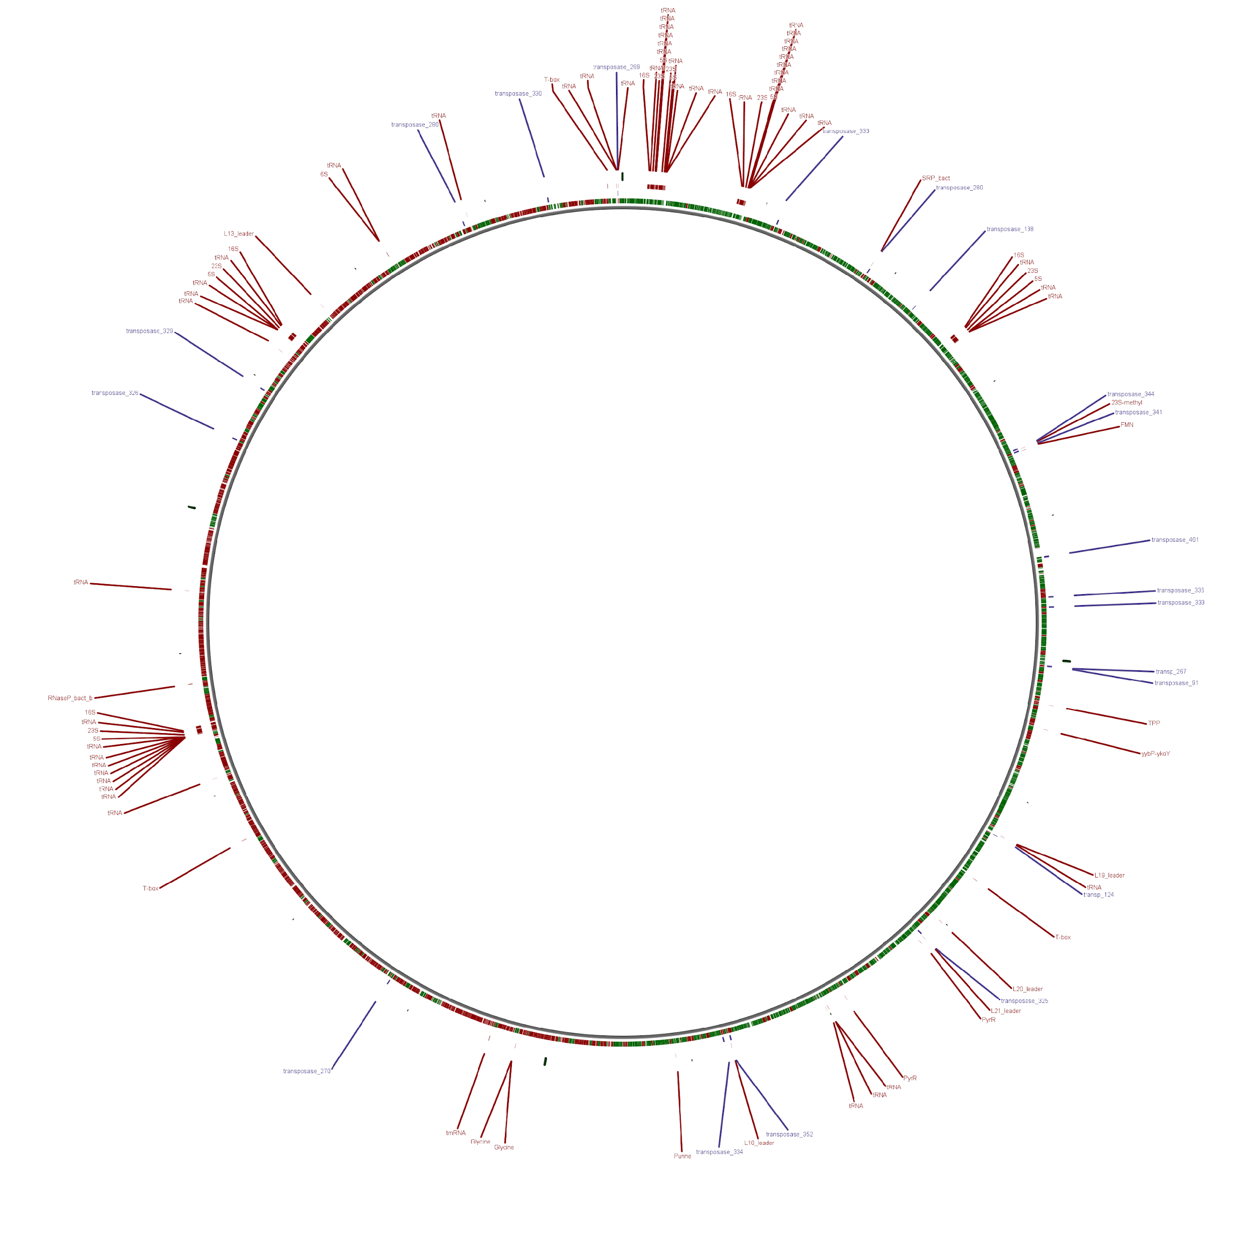
ribosomal regions
(8000 bp)
Reference genome:
S. pyogenes
MGAS8232
ASM728v1 (2002)
1,895,017 bp

Slide 19
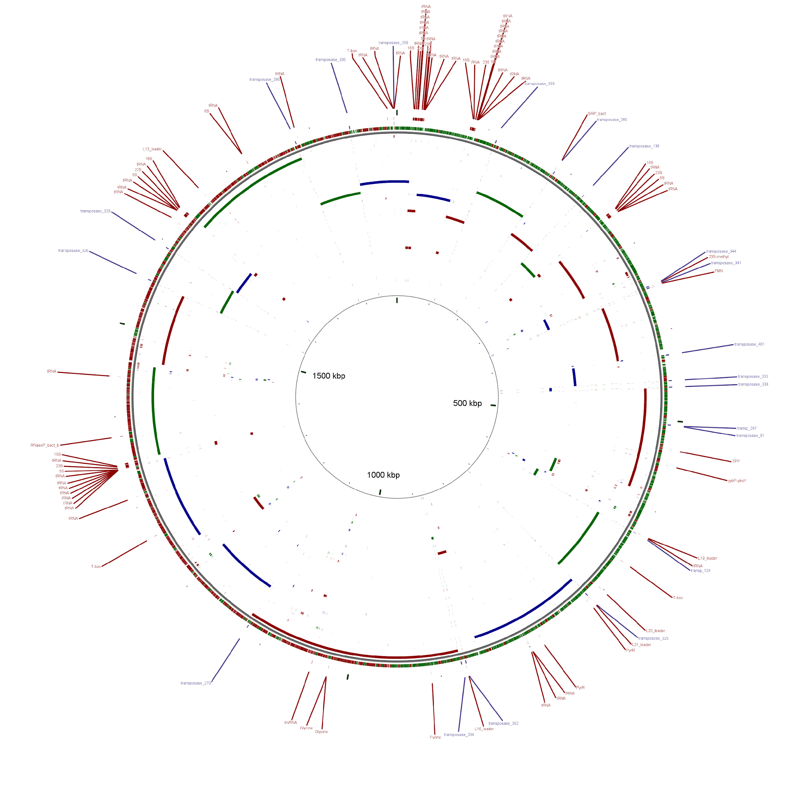
assembly using just paired end reads
Reference genome:
S. pyogenes
MGAS8232
ASM728v1 (2002)
1,895,017 bp

Slide 20
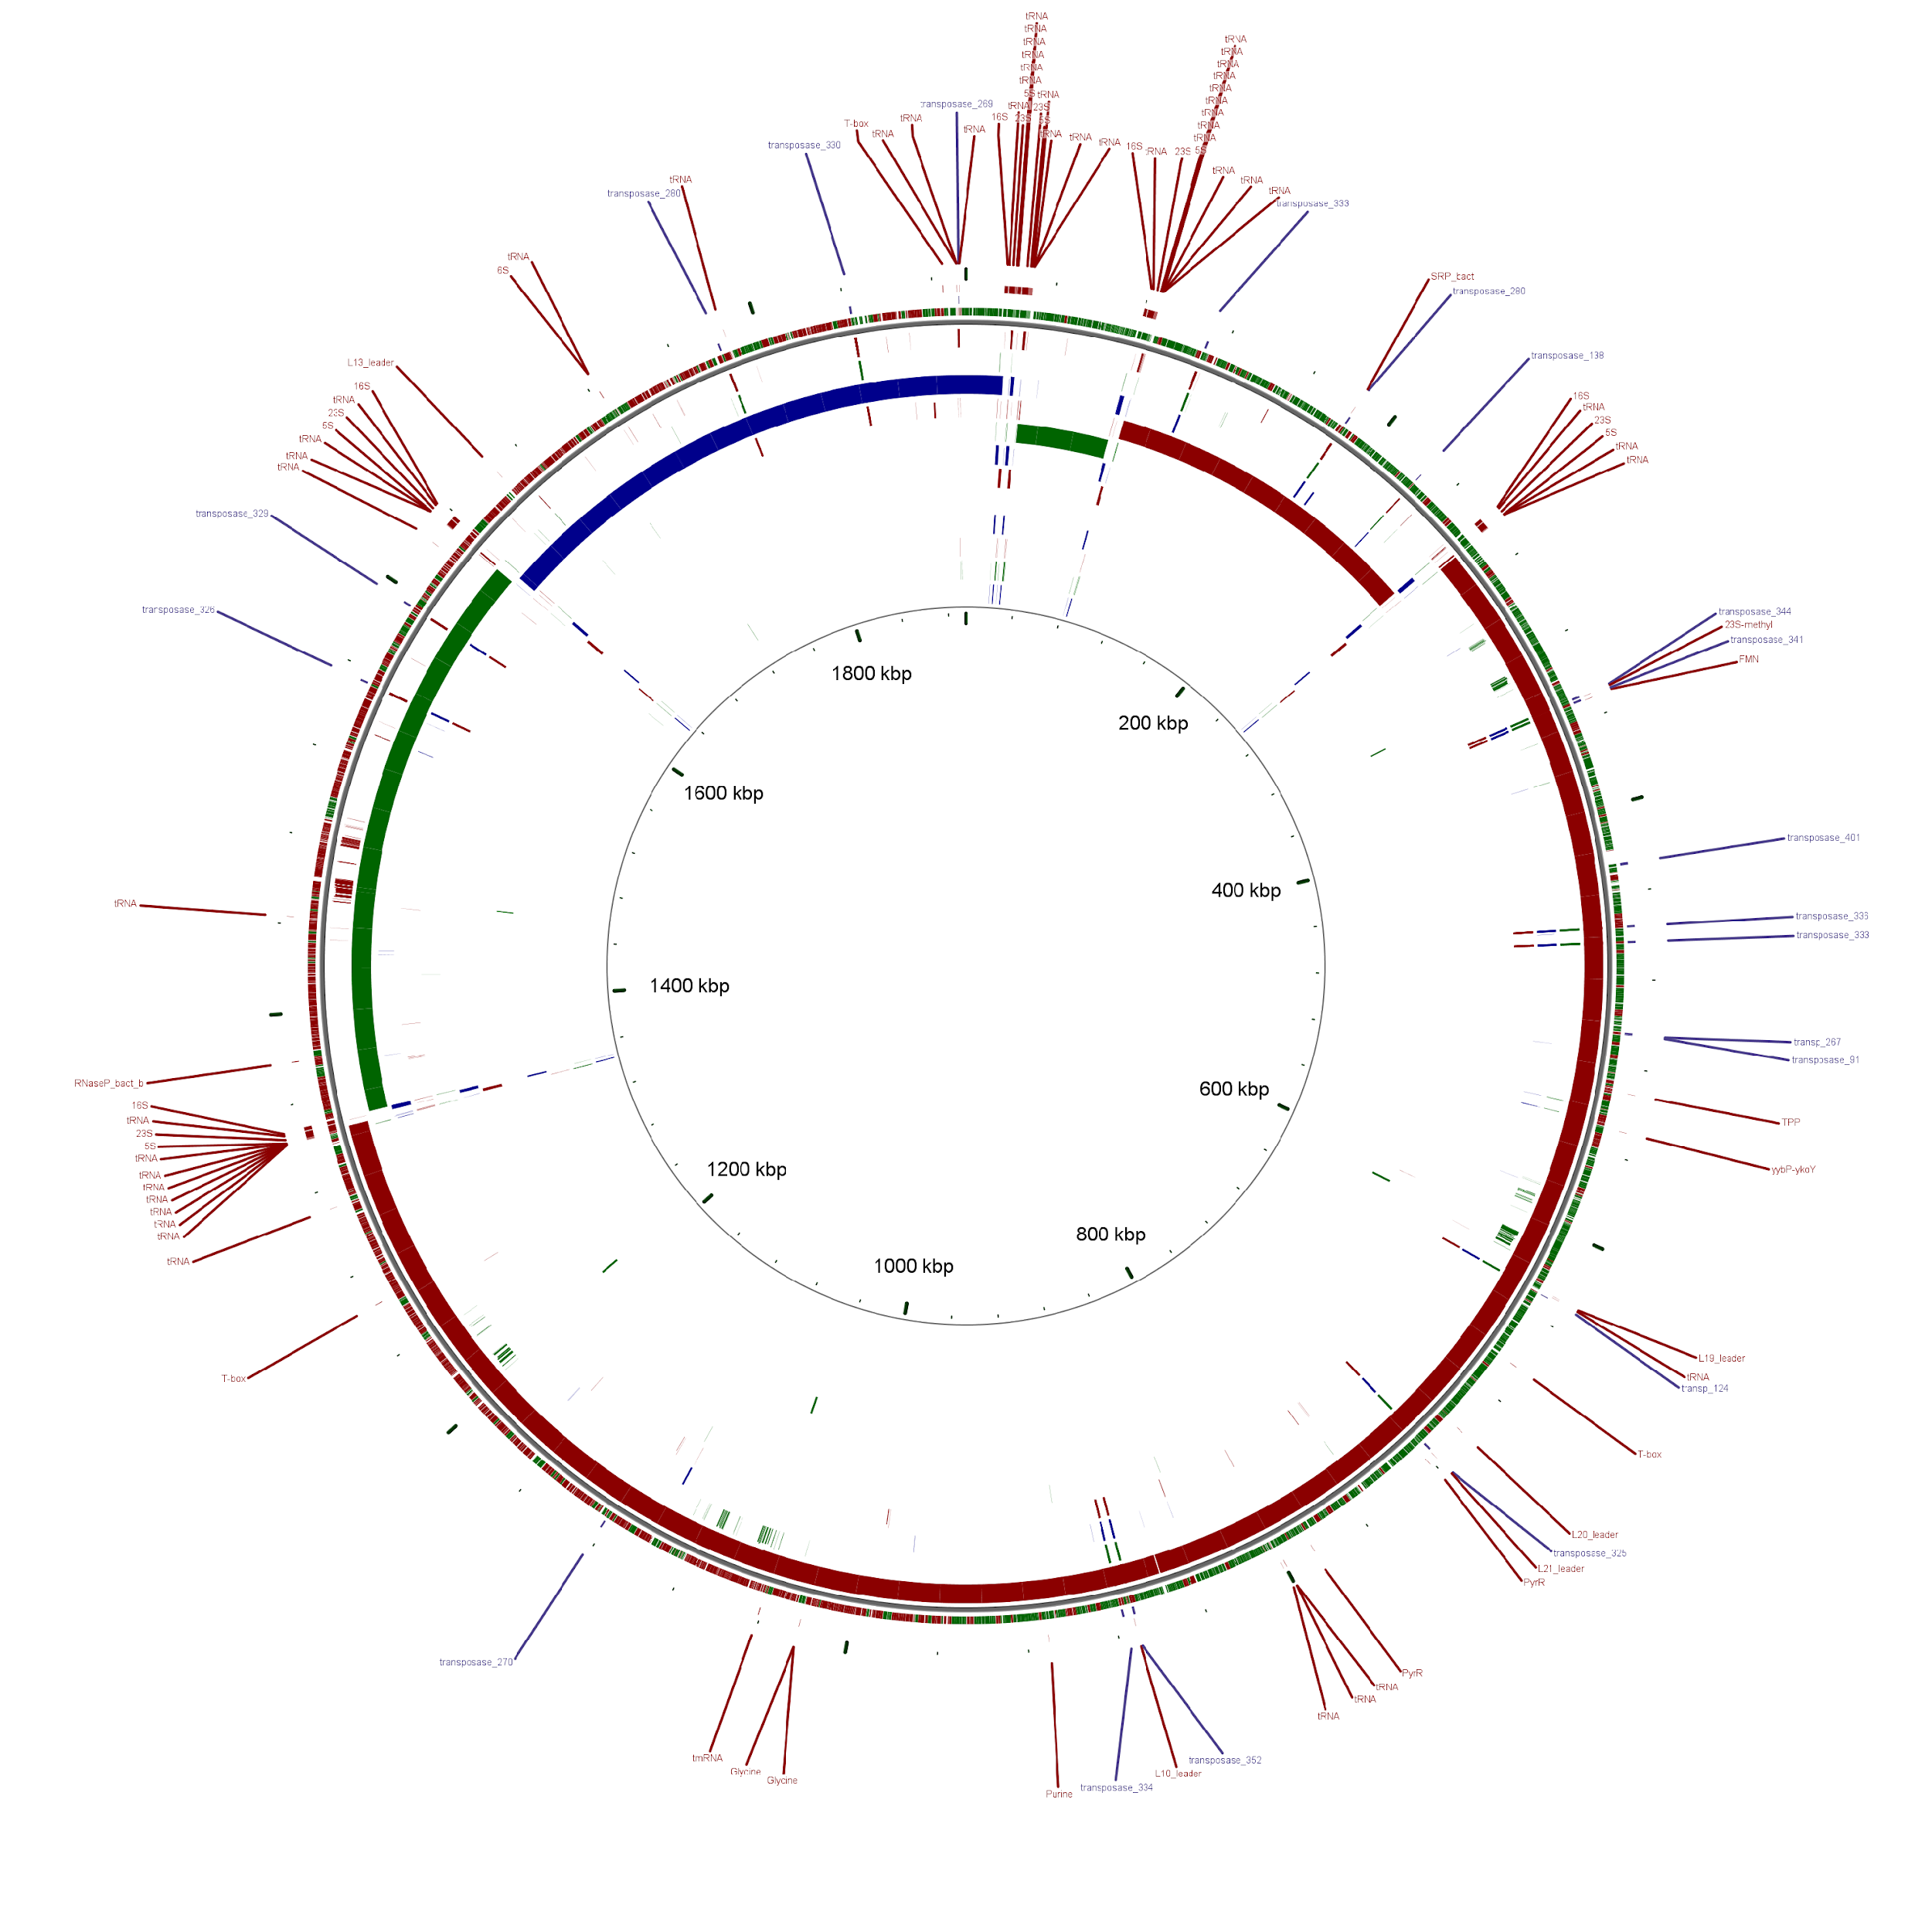
assembly using paired end reads
plus 2kb mate pairs
Reference genome:
S. pyogenes
MGAS8232
ASM728v1 (2002)
1,895,017 bp

Slide 21
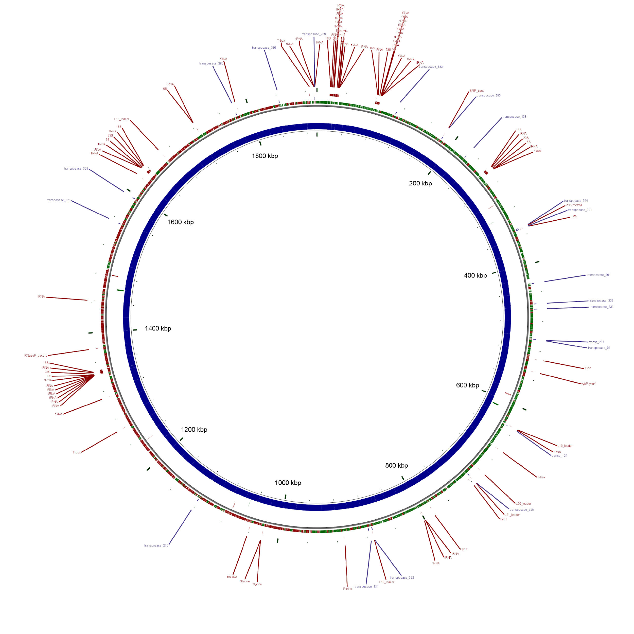
assembly using paired end reads
plus 2kb mate pairs plus 10kb mate pairs
Reference genome:
S. pyogenes
MGAS8232
ASM728v1 (2002)
1,895,017 bp

Slide 22
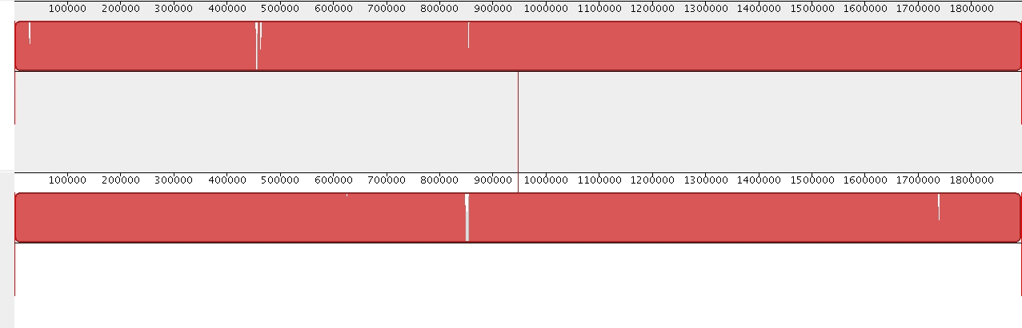
MAUVE Assembly Evaluation

Slide 23
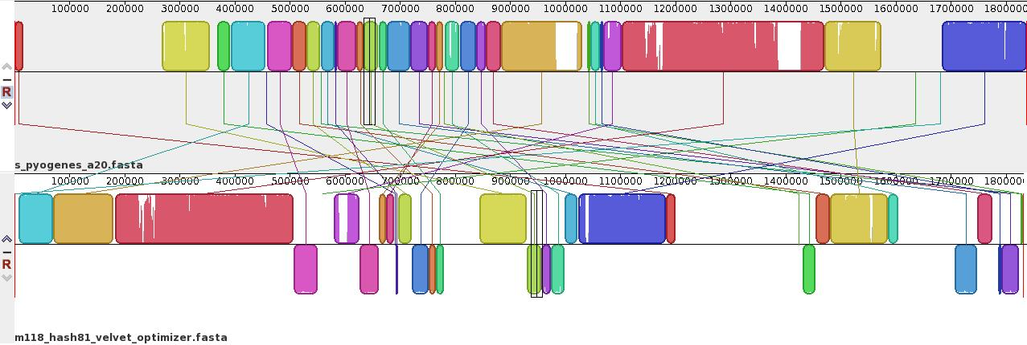
n50 is not always the Best Evaluation
n50: 1,830,792 one large de novo misassembled contig (pe reads only)

Slide 24
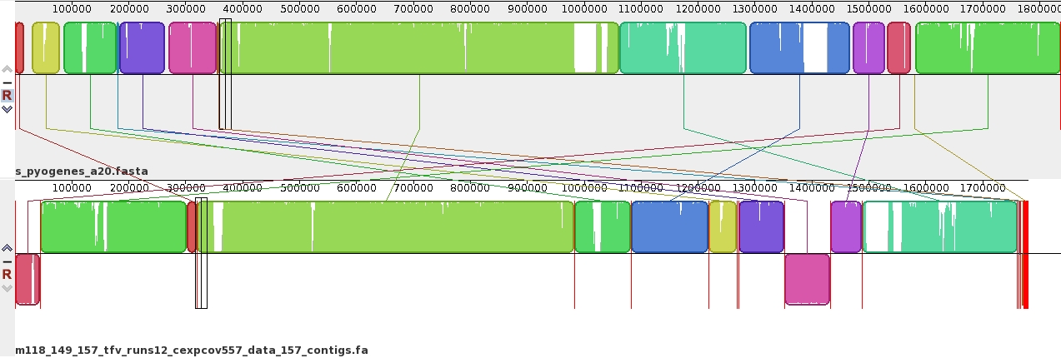
n50 is not always the Best Evaluation
n50: 1,830,792 one large de novo misassembled contig (pe reads only)
n50: 274,562 many smaller better de novo assembled contigs (pe reads only)

Slide 25
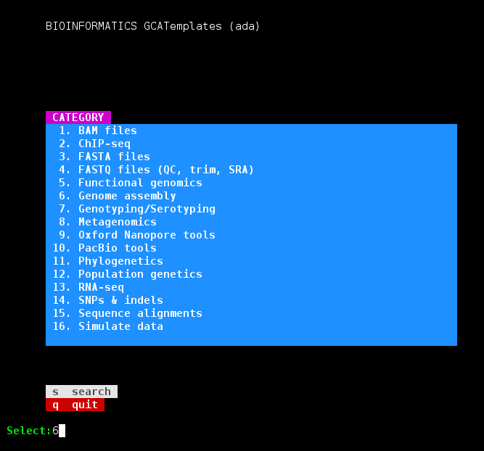
Genome Assembly Exercise using GCATemplates on Ada
gcatemplates
Select #6 then de novo assembly
Use the template for spades_3.11.1
Save the template script to your pwd
Update the template script contents
Change the paired end reads input files to the two paired end output files from your Trimmomatic job script
edit outputs to your data directory
stderr and stdout
spades.py output_directory
Submit the template script to the scheduler
the assembly takes 10 hours

Slide 26
Genome Assembly Exercise using GCATemplates on Ada cont.
Make a copy of the run_spades_3.11.1_pe_2mp_ada.sh script renaming it accordingly
remove the 10kb library from the spades.py command
change the spades output directory and job name (#BSUB -J)
run the new job script
review the results during the next class period
Make a third copy of the run_spades_3.11.1_pe_2mp_ada.sh script
remove both mate pair libraries from the spades.py command
change the spades output directory and job name (#BSUB -J)
run the new job script
review the results during the next class period

Slide 27
Review Statistics for Three Assemblies
Do this exercise once all three assembly jobs have finished
Go to the directory where your spades output directories are located
Compare three assemblies (longest scaffold, number of scaffolds, N50, etc.)
pe, mp2kb, mp10kb
pe, mp2kb
pe
module load GCATemplates
assemblathon_stats.pl build_DR34_pe_mp2kb_mp10kb/scaffolds.fasta
assemblathon_stats.pl build_DR34_pe_mp2kb/scaffolds.fasta
assemblathon_stats.pl build_DR34_pe/scaffolds.fasta

Slide 28
Genome Assembly Assessment
The completeness of a genome can be estimated by using a set of highly conserved genes that are common to specific taxonomic groups
BUSCO – uses single-copy genes to access genome assembly and annotation completeness
evaluates % complete 'BUSCOs', % fragmented, % missing
CEGMA – Core Eukaryotic Gene Mapping Approach: accesses a genome assembly for a small set of highly conserved genes.
Currently no further development planned

Slide 29
Genome Assembly Assessment
gcatemplates
Select #6 then de novo assembly
select gene modeling/prediction/annotation
Use the template for BUSCO
Save the template script to your pwd
Update the template script contents
edit outputs to your data directory
stderr and stdout
BUSCO output_directory
Submit the template script to the scheduler

Slide 30
Genome Assembly Annotation
Alignment tools
module avail Exonerate
protein to genome
shows splice sites, and introns (with lengths)
parse alignments coordinates with BioPerl
ESTs
RNA-seq
module avail GMAP-GSNAP
module avail STAR-STAR
module avail bowtie2
Gene Prediction Tools
module avail geneid
module avail GeneMark-ES
module avail GeneMarkS
module avail SNAP-HMM
module avail Augustus
Genome Annotation Pipeline
module avail MAKER
1 : LeuLeuProArgLeuAspCysSerGlyThrIleSerAlaHisCysAsnLeuPro : 19
|||||||||||||||!!:! !||||||.!!||||||||||||||||||||||||
LeuLeuProArgLeuGluSerSerGlyAlaIleSerAlaHisCysAsnLeuPro-+
1484623 : CTGTTGCCCAGGCTGGAGTCCAGTGGTGCAATCTCGGCTCACTGCAACCTCCCTct : 1484677
20 : >>>> Target Intron 1 >>>> ArgPheLysArgPheSerCysLeuArgLe : 28
35685 bp ! !||||||||||||||||||!!!||
++ValHisLysArgPheSerCysLeuSerLe
1484678 : .........................agGTACACAAGCGATTCTCCTGTCTCAGCCT : 1520389
29 : uPro{T} >>>> Target Intron 2 >>>> {hr}GlyIleThrGlyAlaT : 36
||||{|} 30432 bp {||}||||||! !|||!.!
uPro{T}++ ++{hr}GlyIleArgGlyValA
1520390 : CCCA{A}gt.........................ag{CT}GGGATTAGAGGCGTGC : 1550845
37 : yrHisHisThrTrpIleIlePheAlaPheLeuValGluThrGlyPheHisHisVal : 54
!||||||.!!|||:!!||||||!.!!!.|||||||||||||||||||||||||||
rgHisHisAlaTrpLeuIlePheValLeuLeuValGluThrGlyPheHisHisVal
1550846 : GCCACCATGCCTGGCTAATTTTTGTATTATTAGTAGAGACAGGGTTTCACCATGTT : 1550899
55 : GlyGlnAlaGlyLeuLysLeuLeuThrSerGluGlnLeuGlyAsnThrLysSerAr : 73
|||||||||||||||:!!||||||||||||! :!! ! !!.!:!! |||!:
GlyGlnAlaGlyLeuGluLeuLeuThrSerGlyGluThrProThrSerAlaSerGl
1550900 : GGCCAGGCTGGTCTCGAACTCCTGACCTCGGGTGAGACACCCACCTCAGCCTCCCA : 1550956
74 : gSerArgPro<->Pro{G} >>>> Target Intron 3 >>>> {ly}TrpS : 80
!!!! ! ! !!{|} 80921 bp {||}||||
nThrAlaGlyIleThr{G}++ ++{ly}TrpS
1550957 : AACTGCTGGGATTACA{G}gt.........................ag{GC}TGGA : 1631901
81 : erAlaMetAlaProSerTrpLeuThrAlaSerSerAlaSerArgValHisValIle : 98
|||||:!!|||! !||| !||||||||||||||||||||||||||||||!.!|||
erAlaValAlaLeuSerGlnLeuThrAlaSerSerAlaSerArgValHisAlaIle
1631902 : GTGCAGTGGCACTATCTCAGCTCACTGCAAGCTCTGCCTCCCGGGTTCACGCCATT : 1631955

Slide 31
Genome Assembly Annotation
gcatemplates
Select #6 then de novo assembly
select gene modeling/prediction/annotation
Use the template for MAKER
Save the template script to your pwd
Update the template script contents
edit outputs to your data directory
stderr and stdout
MAKER output_directory
Submit the template script to the scheduler

Slide 32
Example of RNA sequencing
exon intron
pre-mRNA
processed mRNA
AAAAAAAAA
mRNA strands are captured by their Poly(A) tail using Poly(T) coated magnetic beads
cDNA exon region is fragmented and sequenced
TTTTTTTTTTT
TTTTTTTTTTT
TTTTTTTTT
AAAAAAAA
reads are then mapped to a reference genome or reference sequences or assembled

Slide 33
RNA-seq Applications
Differential Expression (DE) and transcript abundance
HISAT2, Bowtie, TopHat, Cufflinks, Cuffmerge, Cuffdiff
DESeq and DESeq2 (R package)
EdgeR (R package)
Transcriptome assembly (find isoforms and rare transcripts)
de novo (Trinity, Oases, SOAPdenovo-Trans)
reference based (Trinity, StringTie)
Genome Annotation
Align to assembly for validation of gene models
Variant Calling
STAR/Picard/GATK (Haplotype Caller (HC) in RNA-seq mode)
de novo genome assembly scaffolding
L_RNA_scaffolder
Identify fusion transcripts
tophat-fusion

Slide 34
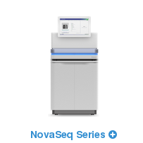
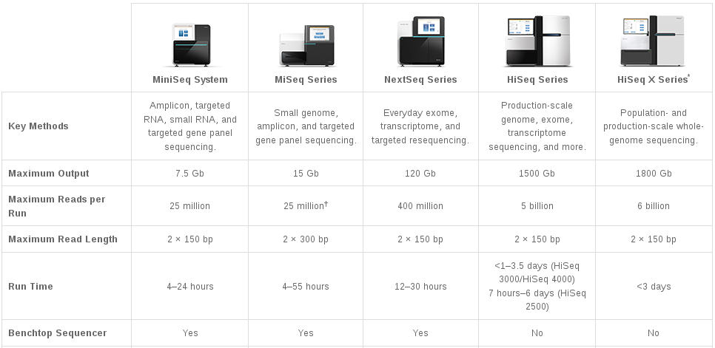
Illumina Sequencing Technology
RNA-seq applications
NovaSeq 5000
Same as HiSeq
2000 Gb
6.6 billion
2 x 150 bp
19 - 40 hrs
no
http://www.illumina.com/systems/sequencing-platforms.html (Oct 2017)

Slide 35
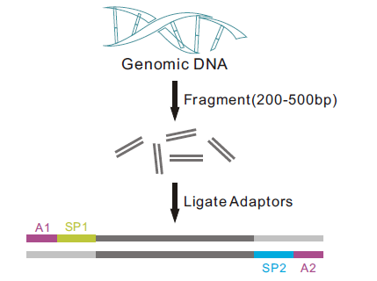
Illumina Sequencing Libraries
illumina.com
single end paired ends
fragment size
~400 bp
~400 bp
sequenced region
(read length)
sequenced regions
(read length)

Slide 36
Biological vs Technical Replication
Biological replicates include multiple samplings within a population
Technical replicates include multiple prepping and or resequencing the same individual
Biological replicates generally increase statistical power more than technical replicates
Biological variability is generally greater than technical variability
Biological replicates contain both biological and technical variability

Slide 37
Quality Control (QC)

Slide 38
RNA-SeQC
module spider RNA-SeQC
Provides alignment metrics & graphs all samples together
Yield alignment and duplication rates
GC bias
rRNA content
Regions of alignment (exon, intron, intragenic)
continuity of coverage
5'/3' bias and much more ...
Metrics can help identify sample outliers by comparing metrics of all samples
RNA-SeQC: RNA-seq metrics for quality control and process optimization
DeLuca, et al. Bioinformatics. 2012 Jun 1; 28(11): 1530–1532. Published online 2012 Apr 25. doi: 10.1093/bioinformatics/bts196PMCID: PMC3356847

Slide 39
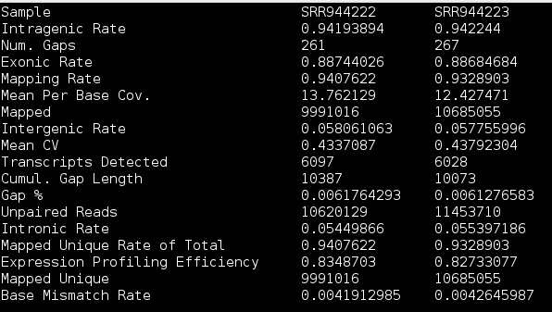
Example of Some of the Metrics Generated by RNA-SeQC

Slide 40
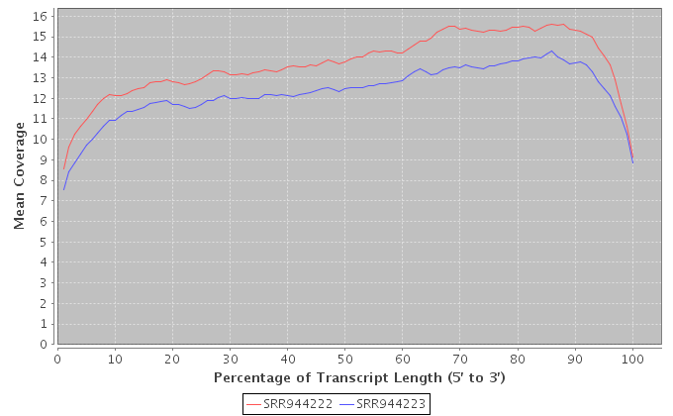
RNA-SeQC meanCoverageNorm_medium
mean coverage for the medium-expressed transcripts over the normalized transcript length
The Mean Coverage profiles are similar for these two samples so there are no gene regional biases between these two samples based on this graph even though the depth are different. You can look for 5’ or 3’ bias of one or more samples compared to others for possible quality issues
Candida albicans RNA-seq

Slide 41
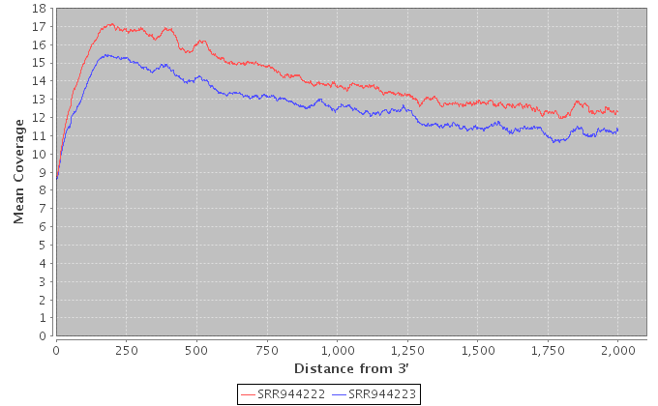
RNA-SeQC meanCoverage_medium
mean coverage for the medium-expressed transcripts over the distance from the 3’ end
The Mean Coverage profiles are similar for these two samples so there are no Distance from 3’ regional biases between these two samples based on this graph even though the depth are different. You can look for depth bias of one or more samples compared to others for possible quality issues
Candida albicans RNA-seq

Slide 42
RNA-seq for Transcriptome Assembly

Slide 43
RNA-seq Transcriptome Assembly
Assembly with a reference genome
de novo assembly without a reference genome
module spider Trinity
module spider HISAT2 Cufflinks
module spider Scripture
module spider StringTie
module spider Trinity
module spider Oases

Slide 44
Digital Normalization for Transcriptome Assembly
Reduce memory requirements by reducing the number of redundant sequence reads if you have a very high sequencing coverage (> 200x)
Trinity 2.4.0+ automatically normalizes reads to a depth of 50
The bbnorm.sh script in BBMap can normalize reads
module spider BBMap

Slide 45
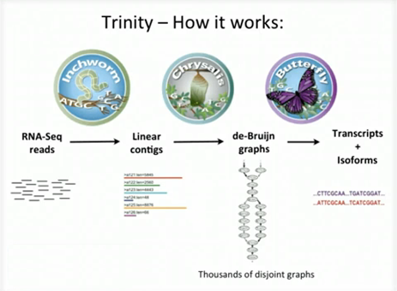
Thousands of disjoint graphs
Broad Institute
ideally one graph per gene/transcript
http://www.rna-seqblog.com/a-collection-of-new-rna-seq-videos-from-the-broad-institute/

Slide 46
Running Trinity on Ada
Trinity uses 100,000s of intermediate files
Contact help@hprc.tamu.edu and request a file quota increase before running Trinity
Run one Trinity job at a time and check resource usage
It is recommended not to run multiple Trinity jobs unless you know memory usage and an estimate of the number of temporary files
Trinity creates checkpoints and can be restarted if it stops due to file/disk quota met, out of memory or runtime
Checkpoints are not available when running Trinity in Galaxy
Checkpoints are not available if you use $TMPDIR with Trinity
need to rsync results from $TMPDIR at end of job script
checkpoints are stored in $TMPDIR which is deleted after job ends
See GCATemplates for sample Trinity scripts
showquota

Slide 47
Running Trinity on Ada 64GB node
Use all cores and memory on a node
There are 54GB available memory on 64GB nodes
#BSUB -n 20
#BSUB -R "span[ptile=20]"
#BSUB -R "rusage[mem=2700]"
#BSUB -M 2700
Recommended Trinity options
--max_memory 53G
--CPU 20
--inchworm_cpu 6
--no_version_check

Slide 48
Running Trinity on Ada 256GB node
Use all cores and memory on a node
There are 246GB available memory on 256GB nodes
#BSUB -n 20
#BSUB -R "span[ptile=20]"
#BSUB -R "rusage[mem=12300]"
#BSUB -M 12300
#BSUB -R "select[mem256gb]"
Recommended Trinity options
--max_memory 245G
--CPU 20
--inchworm_cpu 6
--no_version_check

Slide 49
Running Trinity on Ada 1TB node
Use all cores and memory on a node
There is 1TB avail memory on 1TB nodes
#BSUB -n 40
#BSUB -R "span[ptile=40]"
#BSUB -R "rusage[mem=25000]"
#BSUB -M 25000
#BSUB -q xlarge
#BSUB -R "select[mem1tb]"
Recommended Trinity options
--max_memory 999G
--CPU 40
--inchworm_cpu 6
--no_version_check

Slide 50
Transcriptome Assembly Completeness
The completeness of a transcriptome can be estimated by using a set of highly conserved genes that are common to specific taxonomic groups
44 taxonomic groups available
aves, bacteria, eukaryota, insecta, vertebrata, ...
BUSCO – uses single-copy genes to access transcriptome assembly and annotation completeness
evaluates % complete 'BUSCOs', % fragmented, % missing
can run in genome, transcriptome or protein mode
module spider BUSCO

Slide 51
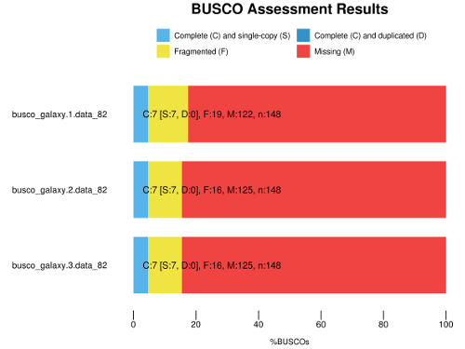
Transcriptome Assembly Completeness
BUSCO script (generate_plot.py) can be used to plot multiple BUSCO short summaries to compare different assemblies
Assembly 1
Assembly 2
Assembly 3

Slide 52
Transcriptome Assembly Evaluation
module spider DETONATE
Input transcriptome fasta assembly and sequence reads fastq or fasta files
RSEM-EVAL used for reference-free evaluation
REF-EVAL used for reference-based evaluation
Higher score = better evaluation
Sample output:
Score -30198099.46
Number_of_contigs 1976
Number_of_alignable_reads 1140584
Number_of_alignments_in_total 1434453

Slide 53
Transcriptome Assembly Evaluation
module spider Transrate
For de novo transcriptome assembly quality analysis
Inputs are combinations of the following
assembly.fa (one or more assemblies)
left.fq (quality trimmed)
right.fq (quality trimmed)
reference.fa
Output
Contig metrics (smallest, largest, N50, %GC, …)
Supports merging assemblies

Slide 54
Transcriptome Assembly Annotation
module spider Trinotate
You can run each of the following tools individually but Trinotate will run all these tools to annotate an assembly
RNAMMER
predicts 5s/8s, 16s/18s, 23s/28s ribosomal RNA
TransDecoder
predicts coding regions
BLAST+ (SwissProt db)
HMMER (PFAM db)
SignalP
predicts presence and location of signal peptide cleavage sites in amino acid sequences
tmhmm
prediction of transmembrane helices in proteins
Results are saved in SQLite db and as a summary file: Trinotate.xls

Slide 55
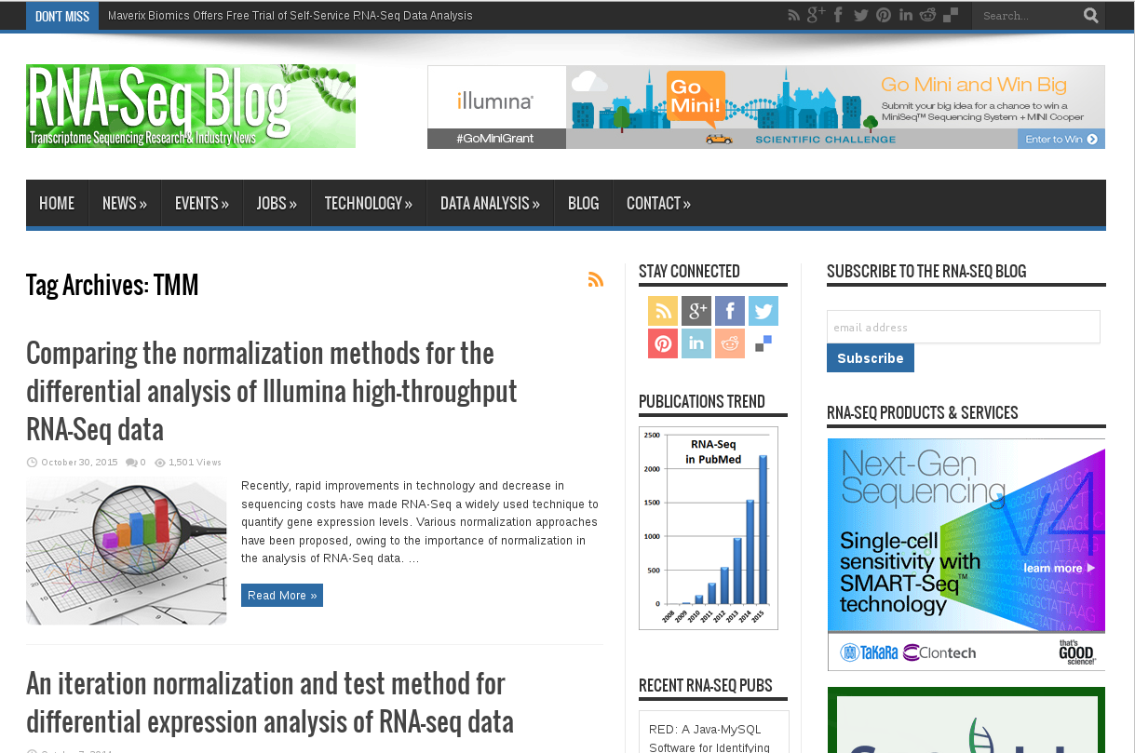

Slide 56

Thank you.
Any question?

